Slide 1
Niswarth Seva Camp
Place : Alonde , Vikramgadh Taluka,Thane district
Date : 27th – 30th December 2012
Organisers: 27 Niswarth sevaks

Slide 2
Thanks to all our supporters!!
We sincerely , from the bottom of our heart thank all are supporters and all are donors who have showed trust and encouraged this set of 27 young NISWARTH SEVAKS . We are obliged to every person who have helped us in cash, kind and giving their valuable time for such a great cause. We expect your continued support for NISWARTH SEVA GROUP to do more such niswarth seva.

Slide 3
School Bags And Books
The School going kids were motivated to learn and go to school by giving them Bags and Books. Around 200 bags were donated in different schools .. ☺

Slide 4
Foodgrains and blanket Donations
Around 100Kgs of each Sugar, wheat and flour were donated in the village…
And also people were given blankets to protect them from the freezing cold during the winters
Happiness on their faces inspired us to work more passionately in future

Slide 5
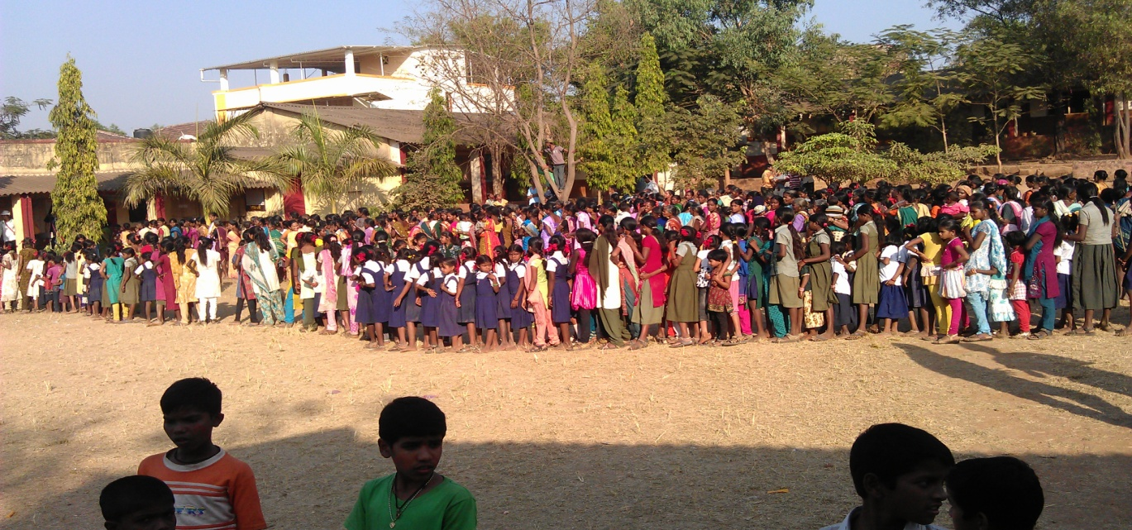
Clothes Donations
The Clothes that were collected from the cities from different places were donated to the villagers ..
There was a huge crowd of more than 500 people gathered to collect these clothes
Every person was delighted to receive clothes .

Slide 6
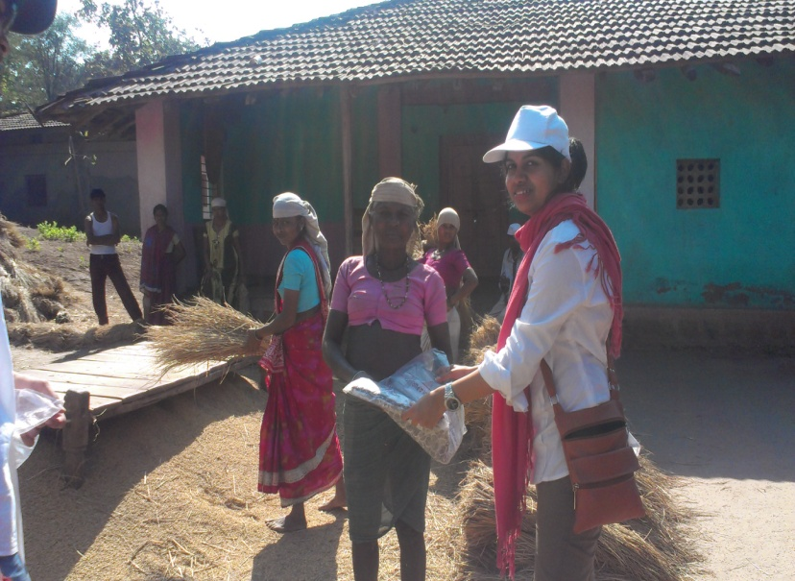
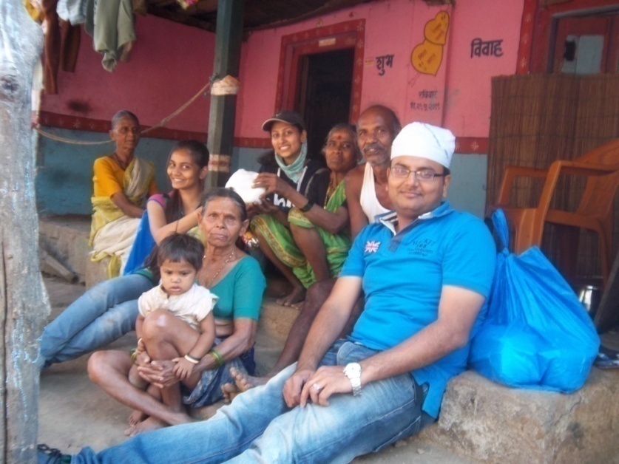
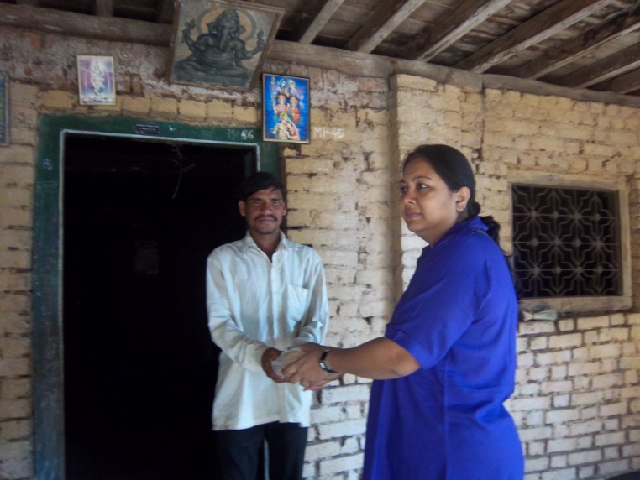
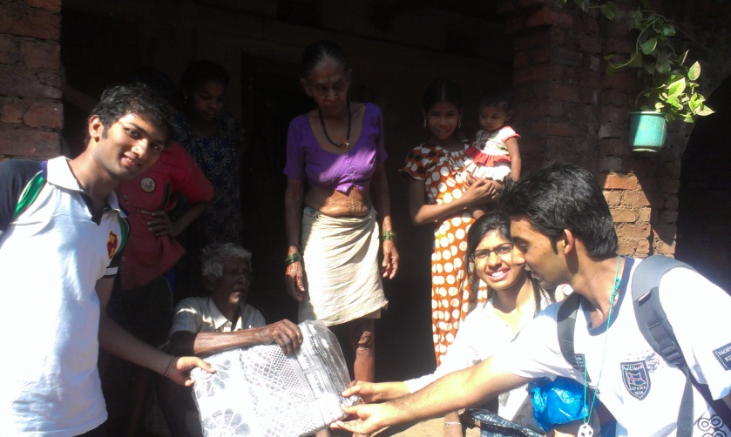

Slide 7
Medical Camp
A Medical Camp was organized where the villagers were tested free of cost and given free medicines
The Medical Camp was a HUGE SUCCESS with 452 villagers turning up for the check up in 1 day..☺

Slide 8
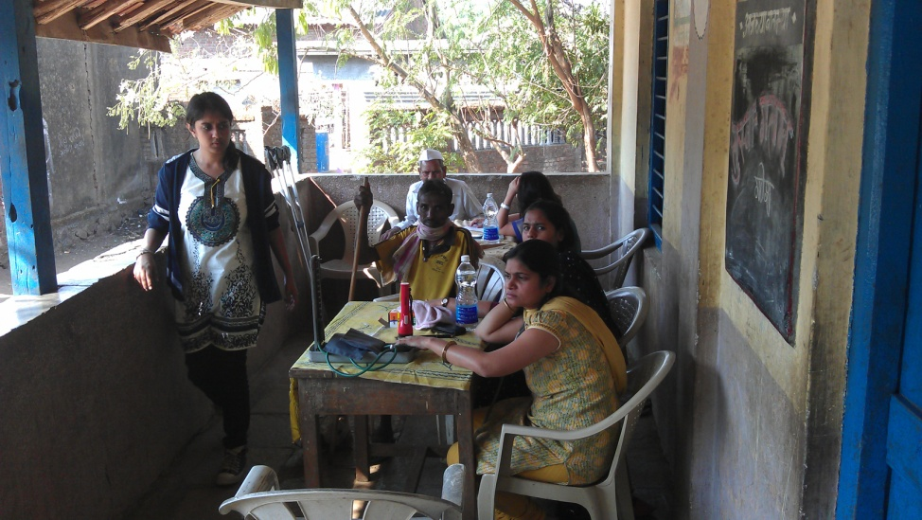
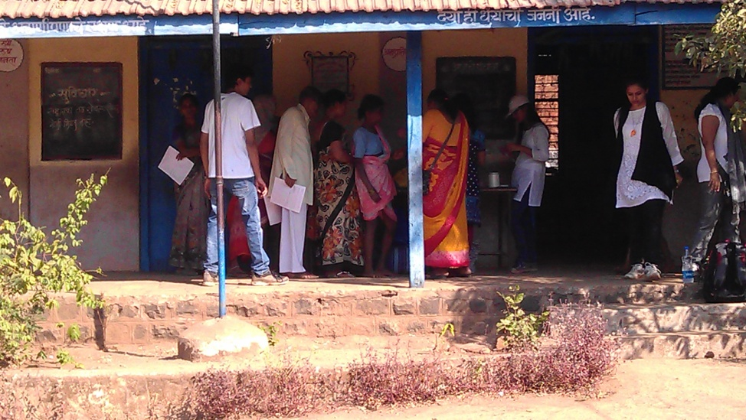
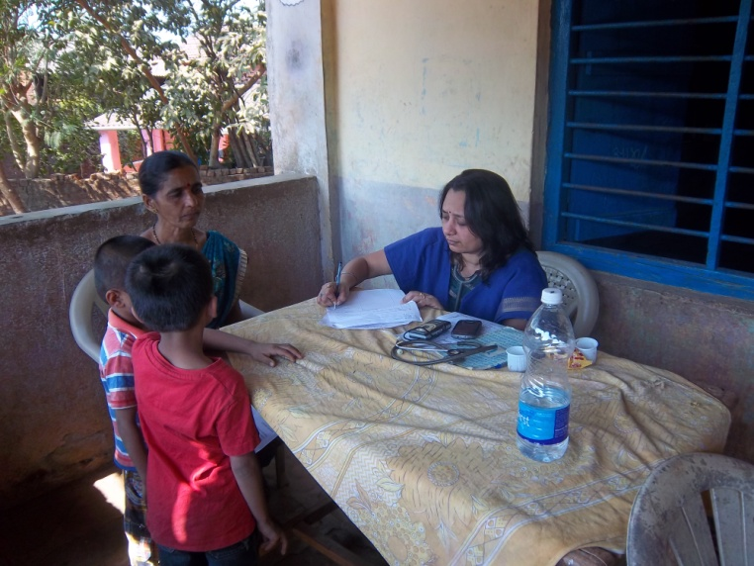
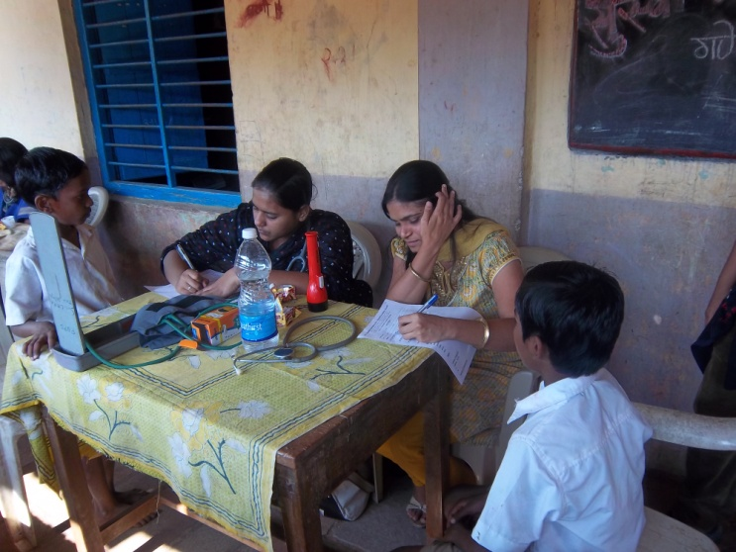

Slide 9
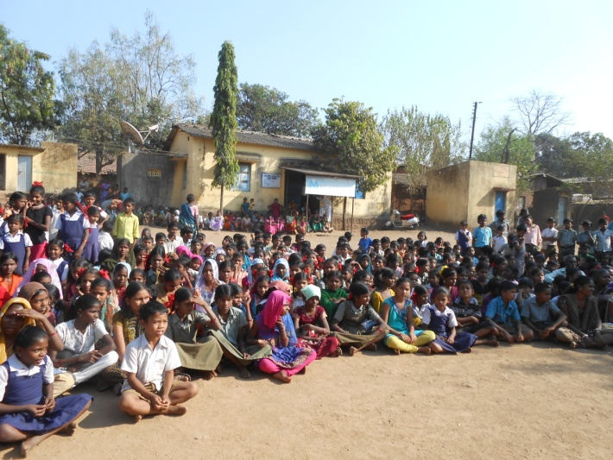
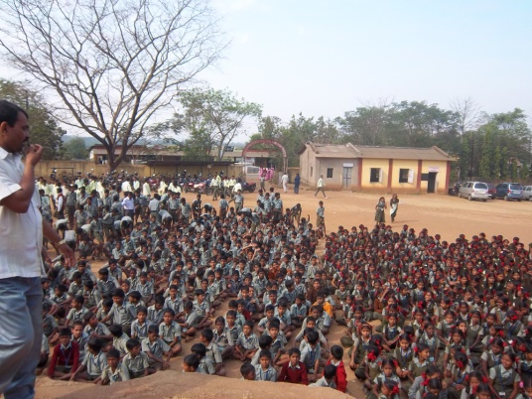
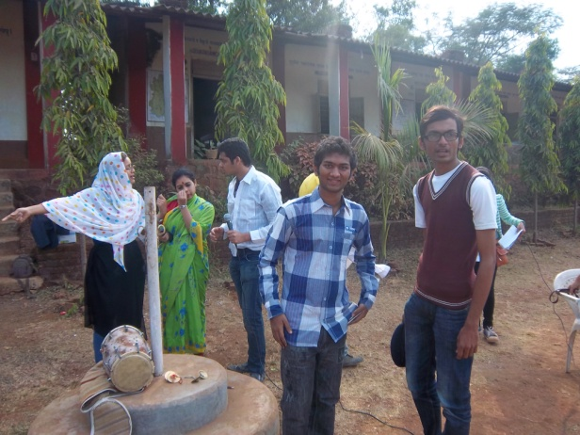
STREET PLAY
A street play which was conducted for the young students of the village and also for the villagers on the topic of alcoholism and saving of money was a great success touching the hearts of all yougsters

Slide 10
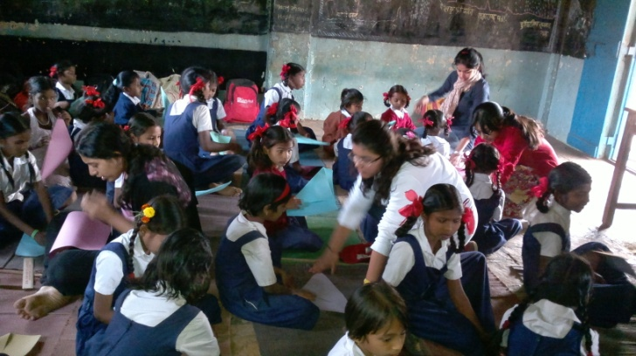
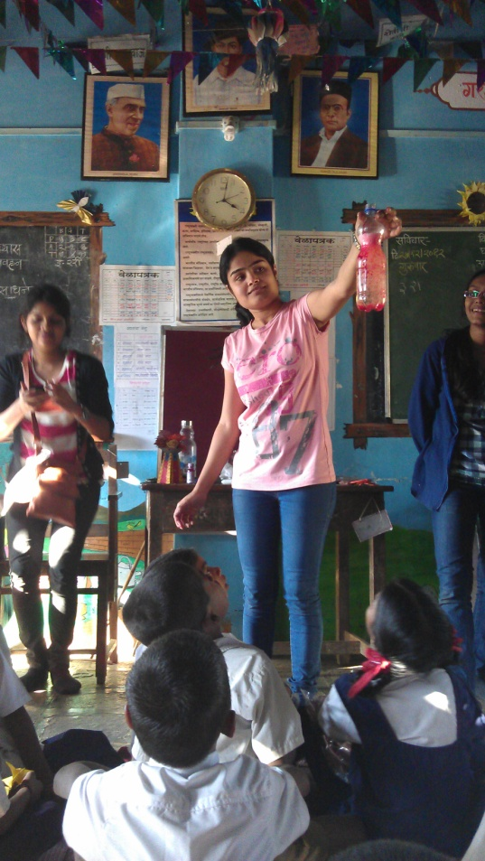
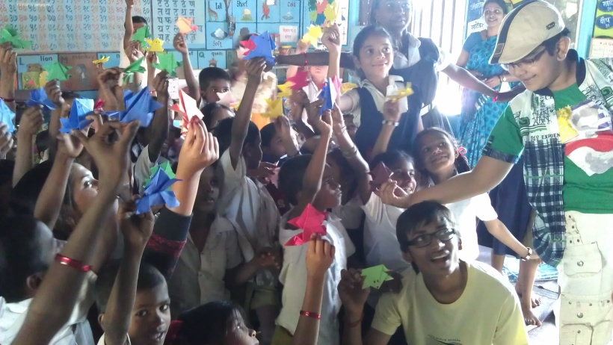
Origami(craft articles) and Experiments

Slide 11
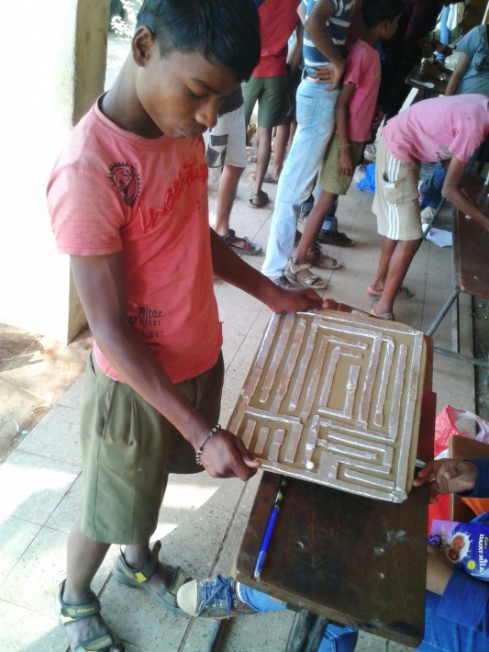
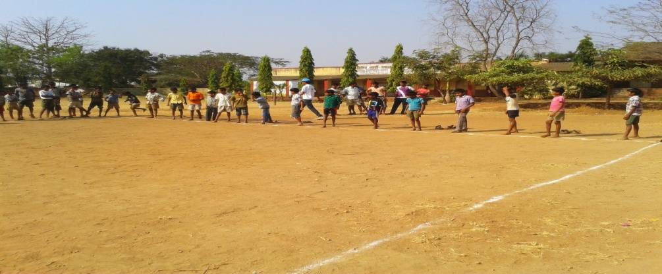
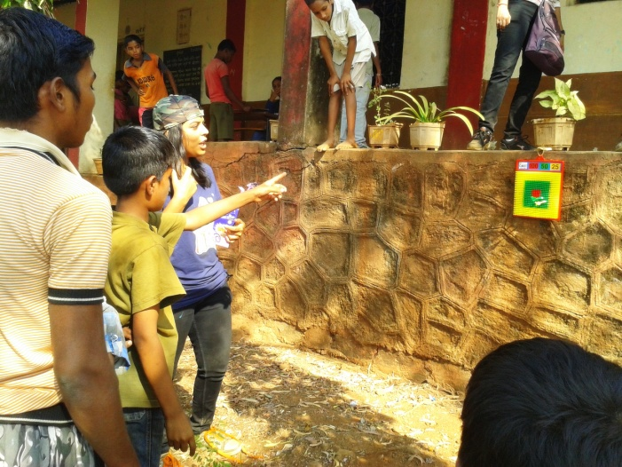
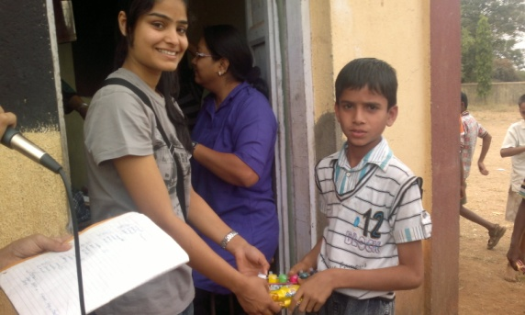
Fun Games & Sports Day

Slide 12
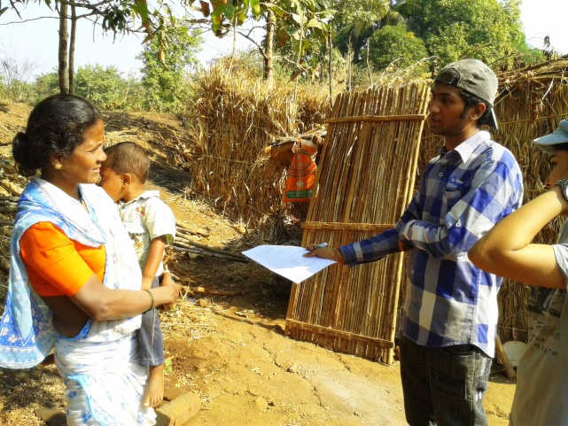
Survey in villages
Out of the 127 Survey forms collected, 35 people were not in a position to disclose their monthly income and hence have not been included in the above.
As can be seen from the pie chart, around half the population earn a meagre of Rs 3000-5000 a month .
Around 30 % earned even below Rs 3000.
This showed how much poor are the people there.

Slide 13
Survey in villages
Out of the sample size of 127, 29 agreed to addiction problems of alcohol (‘taadi’) and tobacco.
Out of the above mentioned sample size, a handy 99 had bank accounts and used bank facilities provided
100% of the sample possessed UID Number (Aadhaar Card) or were in receipt of the acknowledgement of UID number.

Slide 14
Survey in villages
The problems faced by the Villagers :
Water Problems
Electricity Problems
Infrastructure Problems like Roads, No proper development, No cemented house provided even though promised by the Panchayat
Alcoholism
Cleanliness
Problems with Panchayat, Government :
Facilities are not provided properly
Ration is not provided properly
Corruption problems
No proper Infrastructure
Communication Problems with the Panchayat ( the common man was not considered during discussions; various schemes by the government were not deployed)

Slide 15
Summary
27 young students below the age of 21, took up this noble cause for the first time and formed NISWARTH SEVA group.
4 day camp at Alonde village,Thane district.
200 school bags donated
100kg each of wheat,flour and sugar donated to villagers
Also blankets and clothes donated to villagers.
Free Medical check up being done on 452 people and also free medicines given to them.
Street play conducted for the youth to eradicate alcoholism from the roots and also inculcate savings habit.
Taught origami and science experiments to school children
Organised Sports Day for the children and also Fun And Fair for the women.

